Slide 1
One Day Seminar on Compiler Design
Presented by
Dr.I.Vallirathi,
Assistant Professor,
PET Engineering College,
Vallioor.

Slide 2
Syllabus
1. UNIT I INTRODUCTION TO COMPILERS & LEXICAL ANALYSIS
Introduction- Translators- Compilation and Interpretation- Language processors -The Phases of Compiler – Lexical Analysis – Role of Lexical Analyzer – Input Buffering – Specification of Tokens– Recognition of Tokens – Finite Automata – Regular Expressions to Automata NFA, DFA –Minimizing DFA – Language for Specifying Lexical Analyzers – Lex tool.
2. UNIT II SYNTAX ANALYSIS
Role of Parser – Grammars – Context-free grammars – Writing a grammar Top Down Parsing – General Strategies – Recursive Descent Parser Predictive Parser-LL(1) – Parser-Shift Reduce Parser-LR Parser- LR (0)Item Construction of SLR Parsing Table – Introduction to LALR Parser – Error Handling and Recovery in Syntax Analyzer-YACC tool – Design of a syntax Analyzer for a Sample Language
3. UNIT III SYNTAX DIRECTED TRANSLATION & INTERMEDIATE CODE GENERATION
Syntax directed Definitions-Construction of Syntax Tree-Bottom-up Evaluation of S-Attribute Definitions- Design of predictive translator – Type Systems-Specification of a simple type Checker Equivalence of Type Expressions-Type Conversions. Intermediate Languages: Syntax Tree, Three Address Code, Types and Declarations, Translation of Expressions, Type Checking, Back patching.
4. UNIT IV RUN-TIME ENVIRONMENT AND CODE GENERATION
Runtime Environments – source language issues – Storage organization – Storage Allocation Strategies: Static, Stack and Heap allocation – Parameter Passing-Symbol Tables – Dynamic Storage Allocation – Issues in the Design of a code generator – Basic Blocks and Flow graphs – Design of a simple Code Generator – Optimal Code Generation for Expressions– Dynamic Programming Code Generation.
5. UNIT V CODE OPTIMIZATION
Principal Sources of Optimization – Peep-hole optimization – DAG- Optimization of Basic Blocks–Global Data Flow Analysis – Efficient Data Flow Algorithm – Recent trends in Compiler Design
Text Books:
Compilers Principles, Techniques, & Tools, by A.V.Aho, R.Sethi & J.D.Ullman, Pearson Education

Slide 3
Important Questions
Unit I
Phases of compiler
Role of Lexical Analyser
Regular Expressions to Automata
Unit II
Predictive Parser
SLR Parsing Table

Slide 4
Unit III
Syntax directed Definitions-Construction of Syntax Tree
Three Address code
Unit IV
Storage Organization
Basic Block
Design of a simple Code Generator
Unit V
Code Optimization
DAG

Slide 5
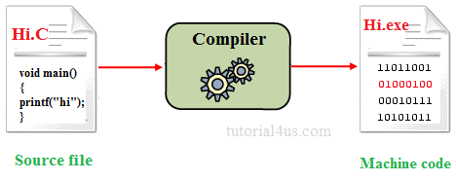
COMPILER
A compiler is a computer program that transforms source code written in a programming language (the source language) into another computer language (the target language), with the latter takes binary form known as object code.
It create an executable program

Slide 6
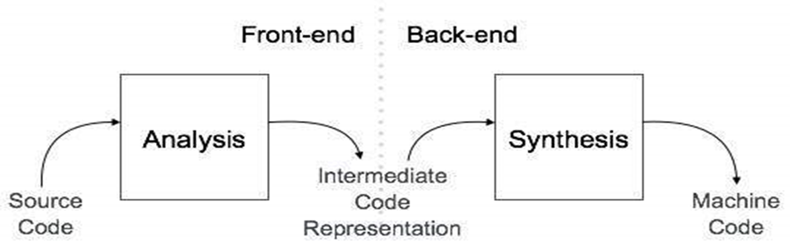
Structure of Compiler
Any compiler must perform two major tasks

Slide 7
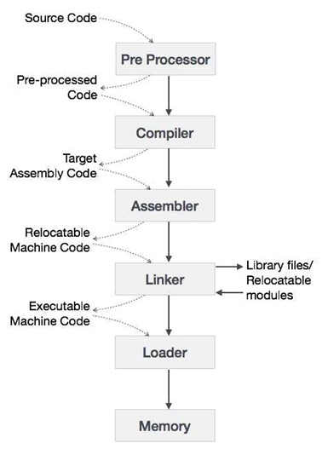
Cousins of compiler

Slide 8
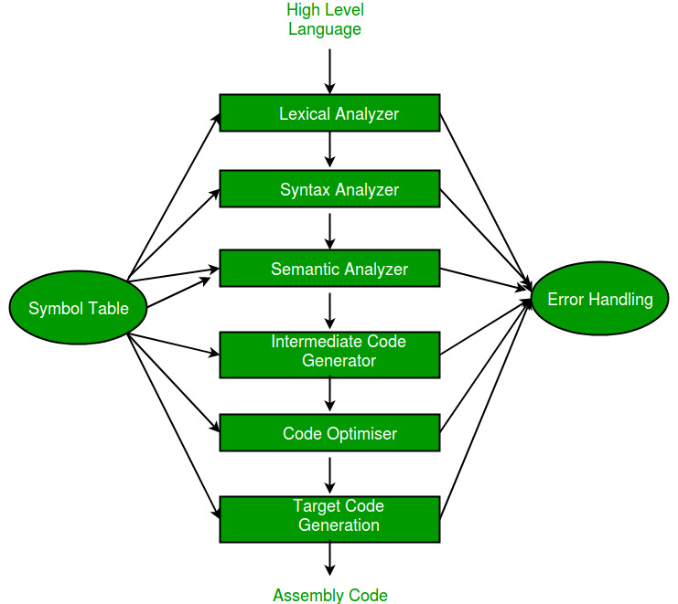
Phases of compiler

Slide 9
Error Handling
The tasks of the Error Handling process are to detect each error, report it to the user, and then make some recover strategy and implement them to handle error. An Error is the blank entries in the symbol table. There are two types of error :
Run-Time Error : A run-time error is an error which takes place during the execution of a program, and usually happens because of adverse system parameters or invalid input data.
Compile-Time Error: Compile-time errors rises at compile time, before execution of the program.

Slide 10
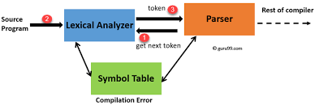
Role of Lexical Analyser

Slide 11
Error handling
Lexical :This includes misspellings of identifiers, keywords or operators.
Syntactical :missing semicolon or unbalanced parenthesis.
Semantical :incompatible value assignment or type mismatches between operator and operand.
Logical :code not reachable, infinite loop.

Slide 12
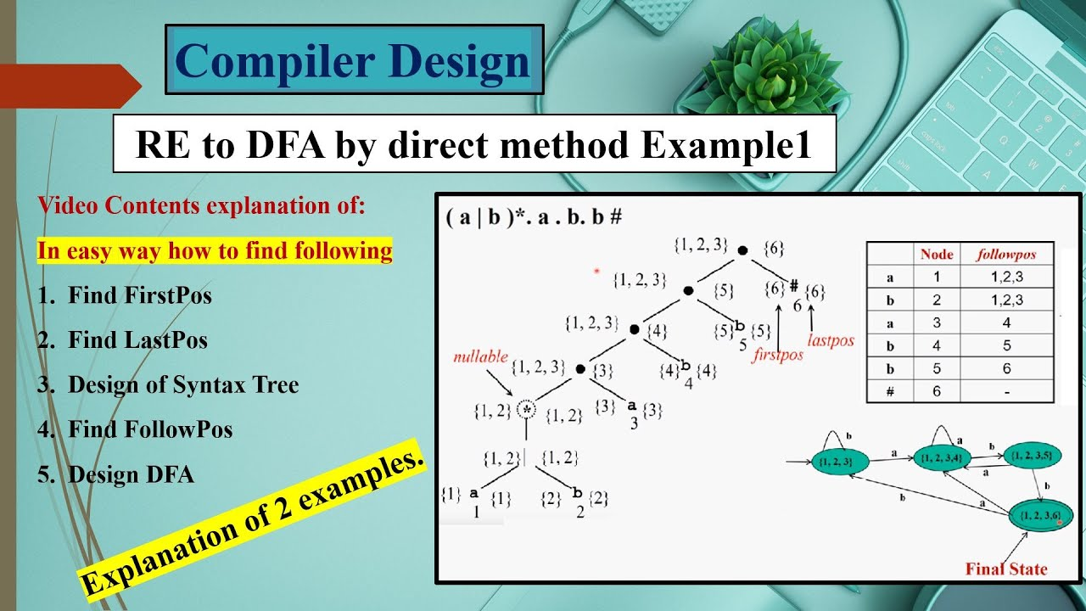
Regular Expression to DFA

Slide 13
Unit II
SYNTAX ANALYSIS

Slide 14
Left recursive and Left Factoring
Left Recursion : The grammar : A -> Aa | a is left recursive. Top down parsing techniques cannot handle left recursive grammar so we convert left recursion into right recursion.
Left recursion elimination : A -> Aa | a ⇒
A -> aA’ A’ -> aA’ |
Left Factoring : If a grammar has common prefixes in r.h.s of nonterminal then sub grammar needs to be left factored by eliminating common prefixes as follows : A -> ab1 | ac2 ⇒
A -> aA’ A’ -> b1 | c2
FIRST(A) is a set of the terminal symbols which occur as first symbols in string derived from A
FOLLOW(A) is the set of terminals which occur immediately after the nonterminal A in the strings derived from the starting symbol.

Slide 15
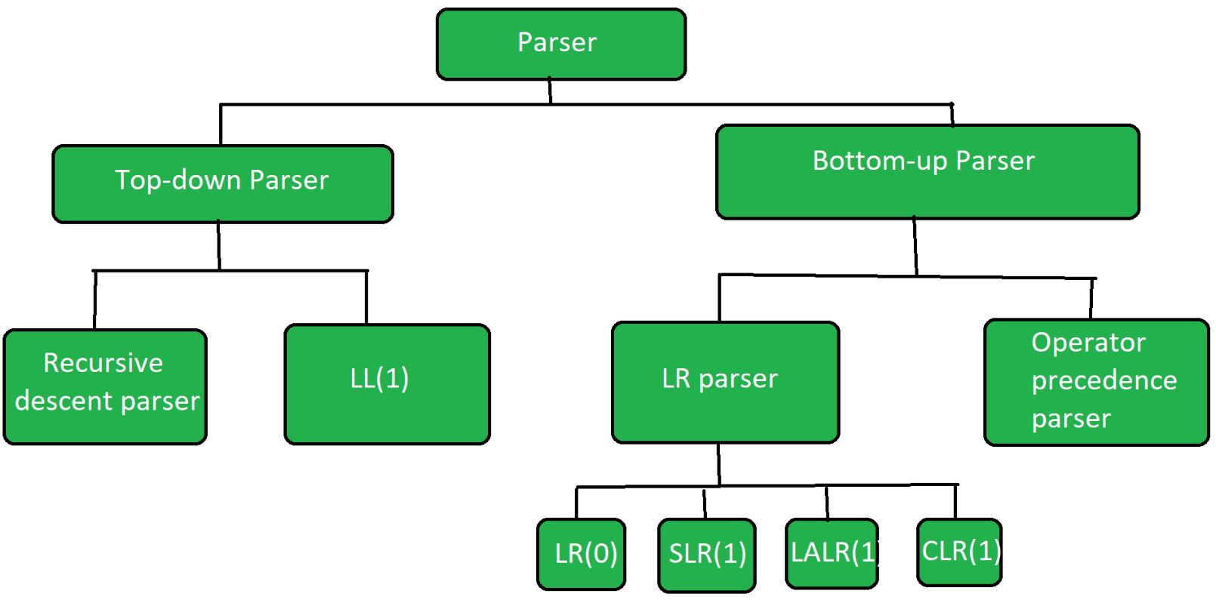
Parser

Slide 16
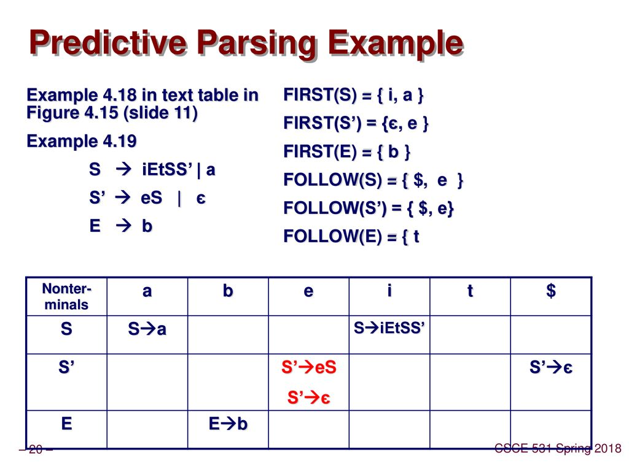
LL(1)

Slide 17
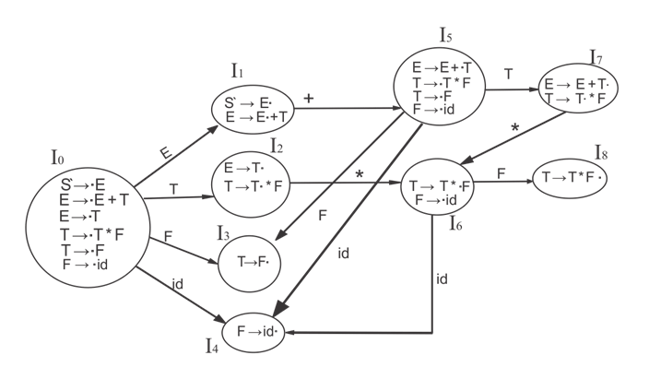
SLR Parser

Slide 18
Unit III
SYNTAX DIRECTED TRANSLATION & INTERMEDIATE CODE GENERATION

Slide 19
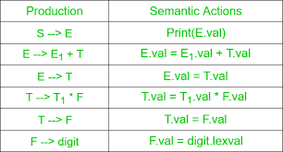
Syntax directed Definitions-Construction of Syntax Tree

Slide 20
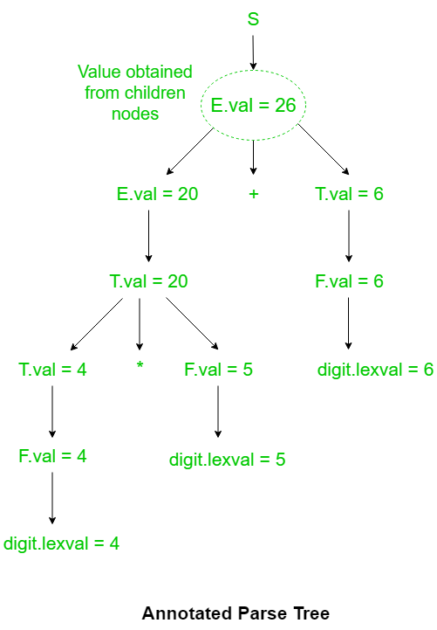

Slide 21
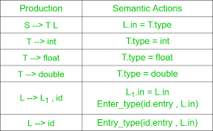
Syntax directed Definitions – Data type

Slide 22
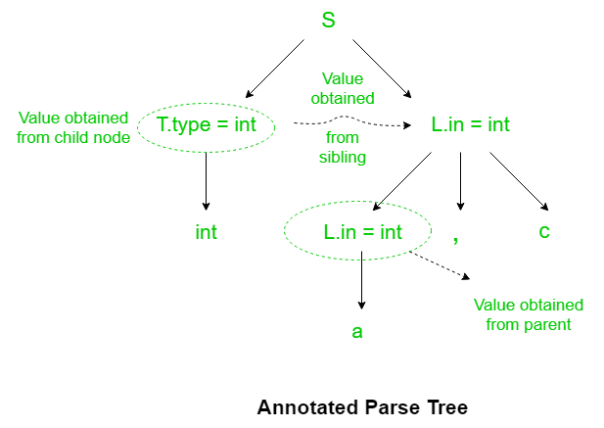

Slide 23
Three address Code Representation
a=b*(-c)+b*(-c)
three address code
t1=uminus(c)
t2=t1*b
t3=uminus(c)
t4=t3*b
t5=t2+t4
a=t5

Slide 24
Three address code: 1. Quadruples (4 fields : operator, operand1, operand2, result) 2. Triplets (3 fields : operator, operand1, operand2) 3. Indirect triples (2 fields : operator, operand)

Slide 25
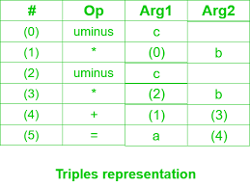
Representation 1

Slide 26
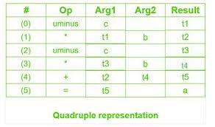
Representation 2

Slide 27
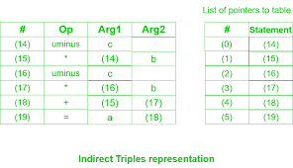
Representation 3

Slide 28
Unit IV
RUN-TIME ENVIRONMENT AND CODE GENERATION

Slide 29
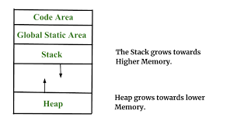
Storage Allocation

Slide 30
Basic Block
Basic Block is a set of statements that always executes one after other, in a sequence.
Algorithm: Partitioning three-address code into basic blocks.
Input: A sequence of three address instructions.
Process: Instructions from intermediate code which are leaders are determined.
The following are the rules used for finding a leader:
The first three-address instruction of the intermediate code is a leader.
Instructions that are targets of unconditional or conditional jump/goto statements are leaders.
Instructions that immediately follow unconditional or conditional jump/goto statements are considered leaders.
Each leader thus determined its basic block contains itself and all instructions up to excluding the next leader.

Slide 31
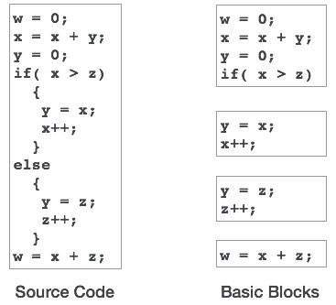

Slide 32
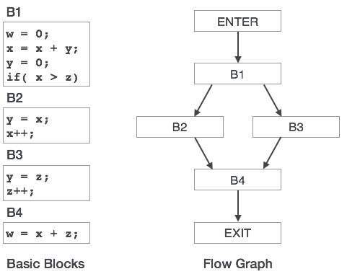
Flow Graph

Slide 33
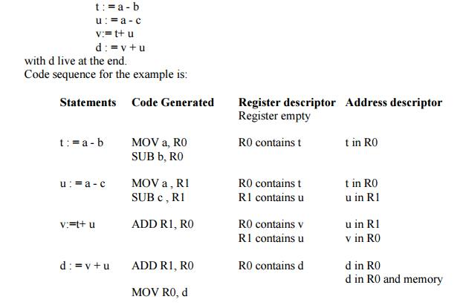
Design of Simple code Generation

Slide 34
Unit V
CODE OPTIMIZATION

Slide 35
Code Optimization :
Types of machine independent optimizations
1. Loop optimizations :
Code motion : reduce the evaluation frequency of expression.
Loop unrolling : to execute less number of iterations
Loop jamming : combine body of two loops whenever they are sharing same index.
2. Constant folding : replacing the value of constants during compilation
3. Constant propagation : replacing the value of an expression during compile time.
4. Strength reduction : replacing costly operators by simple operators.

Slide 36
Code Optimization
The code optimization in the synthesis phase is a program transformation technique, which tries to improve the intermediate code by making it consume fewer resources (i.e. CPU, Memory) so that faster-running machine code will result. Compiler optimizing process should meet the following objectives :
The optimization must be correct, it must not, in any way, change the meaning of the program.
Optimization should increase the speed and performance of the program.
The compilation time must be kept reasonable.
The optimization process should not delay the overall compiling process.

Slide 37
When to Optimize?
Optimization of the code is often performed at the end of the development stage since it reduces readability and adds code that is used to increase the performance.

Slide 38
Why Optimize?
Optimizing an algorithm is beyond the scope of the code optimization phase. So the program is optimized. And it may involve reducing the size of the code. So optimization helps to:
Reduce the space consumed and increases the speed of compilation.
Manually analyzing datasets involves a lot of time. Hence we make use of software like Tableau for data analysis. Similarly manually performing the optimization is also tedious and is better done using a code optimizer.
An optimized code often promotes re-usability.

Slide 39
Types of Code Optimization
Machine Independent Optimization: This code optimization phase attempts to improve the intermediate code to get a better target code as the output. The part of the intermediate code which is transformed here does not involve any CPU registers or absolute memory locations.
Machine Dependent Optimization: Machine-dependent optimization is done after the target code has been generated and when the code is transformed according to the target machine architecture. It involves CPU registers and may have absolute memory references rather than relative references. Machine-dependent optimizers put efforts to take maximum advantage of the memory hierarchy.

Slide 40
1. Compile Time Evaluation
(i) A = 2*(22.0/7.0)*r
Perform 2*(22.0/7.0)*r at compile time.
(ii) x = 12.4
y = x/2.3
Evaluate x/2.3 as 12.4/2.3 at compile time.

Slide 41
2. Variable Propagation
//Before Optimization
c = a * b
x = a
till
d = x * b + 4
//After Optimization
c = a * b
x = a
till
d = a * b + 4

Slide 42
3. Constant Propagation
If the value of a variable is a constant, then replace the variable with the constant. The variable may not always be a constant.
(i) A = 2*(22.0/7.0)*r
Performs 2*(22.0/7.0)*r at compile time.
(ii) x = 12.4
y = x/2.3
Evaluates x/2.3 as 12.4/2.3 at compile time.
(iii) int k=2;
if(k) go to L3;
It is evaluated as :
go to L3 ( Because k = 2 which implies condition is always true)

Slide 43
4. Constant Folding
Consider an expression : a = b op c and the values b and c are constants, then the value of a can be computed at compile time.
#define k 5
x = 2 * k
y = k + 5
This can be computed at compile time and the values of x and y are :
x = 10
y = 10

Slide 44
5. Copy Propagation
It is extension of constant propagation.
After a is assigned to x, use a to replace x till a is assigned again to another variable or value or expression.
It helps in reducing the compile time as it reduces copying.
//Before Optimization
c = a * b
x = a
till
d = x * b + 4
//After Optimization
c = a * b
x = a
till
d = a * b + 4

Slide 45
6. Common Sub Expression Elimination
In the above example, a*b and x*b is a common sub expression

Slide 46
7. Dead Code Elimination
Copy propagation often leads to making assignment statements into dead code.
A variable is said to be dead if it is never used after its last definition.
In order to find the dead variables, a data flow analysis should be done
c = a * b
x = a
till
d = a * b + 4
//After elimination :
c = a * b
till
d = a * b + 4

Slide 47
8. Unreachable Code Elimination
First, Control Flow Graph should be constructed.
The block which does not have an incoming edge is an Unreachable code block.
After constant propagation and constant folding, the unreachable branches can be eliminated.

Slide 48
9. Induction Variable and Strength Reduction
An induction variable is used in the loop for the following kind of assignment i = i + constant. It is a kind of Loop Optimization Technique.
Strength reduction means replacing the high strength operator with a low strength.

Slide 49
Loop Optimization Techniques

Slide 50
1. Code Motion or Frequency Reduction
The evaluation frequency of expression is reduced.
The loop invariant statements are brought out of the loop.
a = 200;
while(a>0)
{
b = x + y;
if (a % b == 0)
printf(“%d”, a);
}
//This code can be further optimized as
a = 200;
b = x + y;
while(a>0)
{
if (a % b == 0}
printf(“%d”, a);
}

Slide 51
2. Loop Jamming
Two or more loops are combined in a single loop. It helps in reducing the compile time.
// Before loop jamming
for(int k=0;k<10;k++)
{
x = k*2;
}
for(int k=0;k<10;k++)
{
y = k+3;
}
//After loop jamming
for(int k=0;k<10;k++)
{
x = k*2;
y = k+3;
}

Slide 52
3. Loop Unrolling
It helps in optimizing the execution time of the program by reducing the iterations.
It increases the program’s speed by eliminating the loop control and test instructions.
//Before Loop Unrolling
for(int i=0;i<2;i++)
{
printf("Hello");
}
//After Loop Unrolling
printf("Hello");
printf("Hello");

Slide 53
Peephole Optimization
The objective of peephole optimization is as follows:
To improve performance
To reduce memory footprint
To reduce code size

Slide 54
A. Redundant load and store elimination
In this technique, redundancy is eliminated
Initial code: y = x + 5; i = y; z = i; w = z * 3; Optimized code: y = x + 5; w = y * 3; //* there is no i now //* We've removed two redundant variables i & z whose value were just being copied from one another.

Slide 55
B. Constant folding
The code that can be simplified by the user itself, is simplified. Here simplification to be done at runtime are replaced with simplified code to avoid additional computation.
Initial code: x = 2 * 3; Optimized code: x = 6;

Slide 56
C. Strength Reduction
The operators that consume higher execution time are replaced by the operators consuming less execution time
Initial code: y = x * 2; Optimized code: y = x + x; or y = x << 1; Initial code: y = x / 2; Optimized code: y = x >> 1;

Slide 57
D. Simplify Algebraic Expressions
Useless operations are deleted
a := a + 0; a := a * 1; a := a/1; a := a - 0;

Slide 58
F. Deadcode Elimination
Dead code refers to portions of the program that are never executed or do not affect the program’s observable behavior. Eliminating dead code helps improve the efficiency and performance of the compiled program by reducing unnecessary computations and memory usage.

Slide 59
Initial Code:- int Dead(void) { int a=10; int z=50; int c; c=z*5; printf(c); a=20; a=a*10; //No need of These Two Lines return 0; }
Optimized Code:- int Dead(void) { int a=10; int z=50; int c; c=z*5; printf(c); return 0; }

Slide 60
Directed a Cyclic Graph
Consider
X= (a+b)+c+(a+b)
Three Address code
t0=a+b
t1=t0+c
t2=t0+t1
X=t2

Slide 61
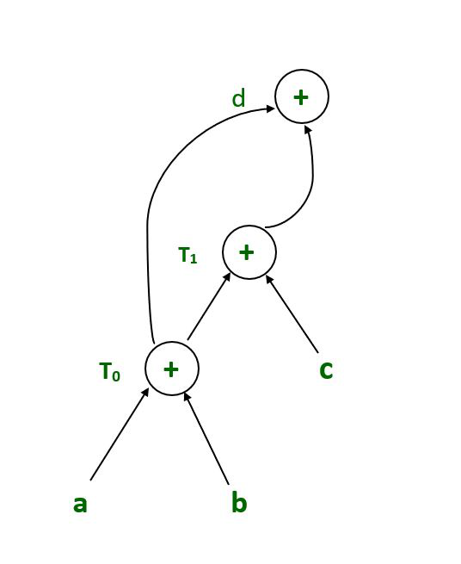
DAG

Slide 62
Thank You

